Slide 1

Alumni Database
Management System
Group no:-06

Slide 2

Introduction
Alumni association.
Guide junior.
Building connection.
Development of college.

Slide 3
Tools and Technologies Used
Front end-
HTML
CSS
Bootstrap
JavaScript
PHP
Backend -
MySQL

Slide 4
Literature Survey
Existing System
Proposed system
Limitations in Existing System
Advantages over existing system

Slide 5
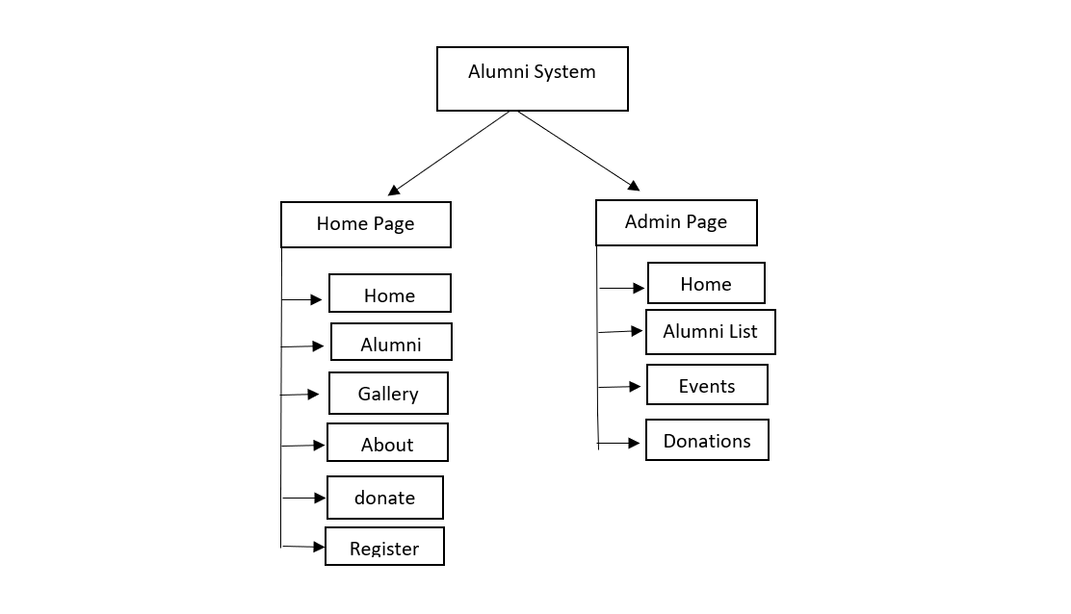
Data Flow Diagram:

Slide 6
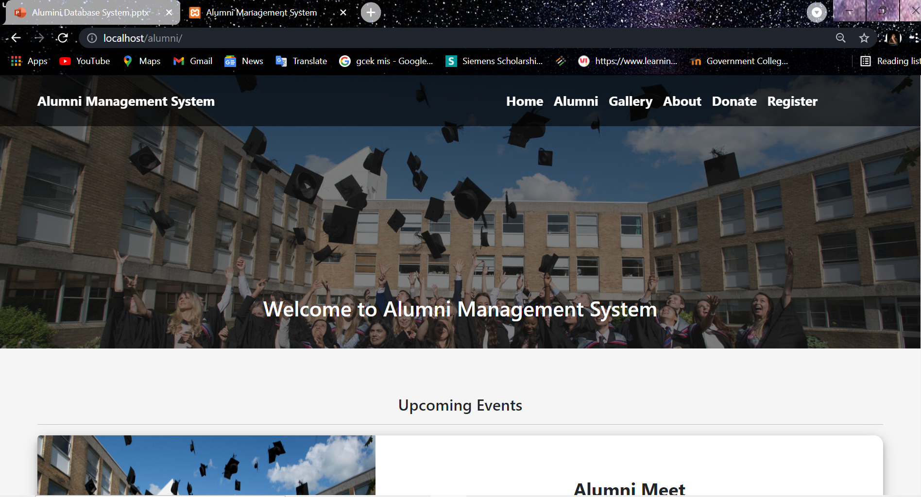

Slide 7
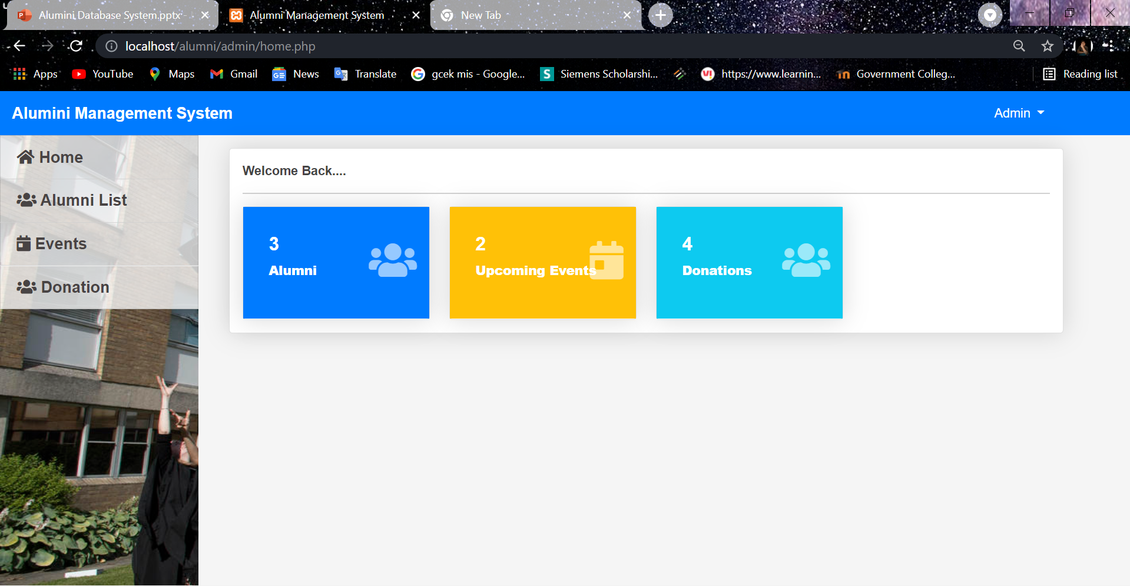

Slide 8
STRENGHTS
S
Growing alumni support
Successful use of career services by young alumni
WEAKNESS
W
Low fundraising activities
Weak identification at institute level
OPPORNTUNITIES
O
Create stronger database
Enhance employability opportunities for graduates
THREATS
T
Decrease of support by donors
Reduction frequency of newsletters

Slide 9
Future Improvements
Chat
Setting Personal Private/Public
Profile Update
Forum

Slide 10
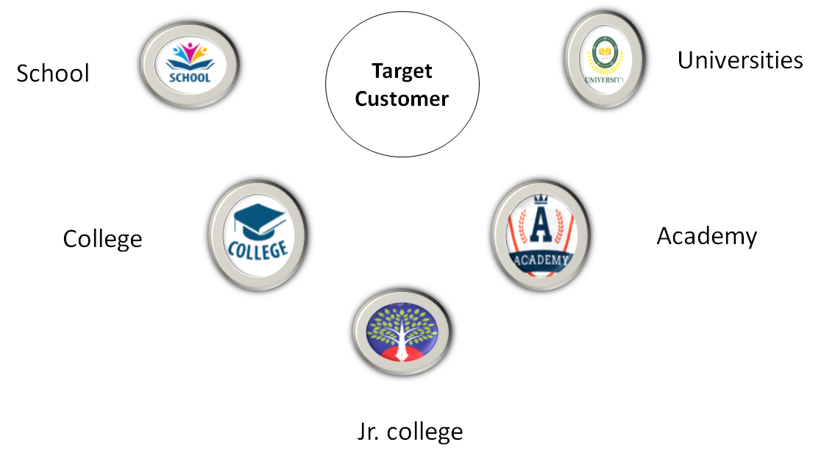

Slide 11










Slide 12
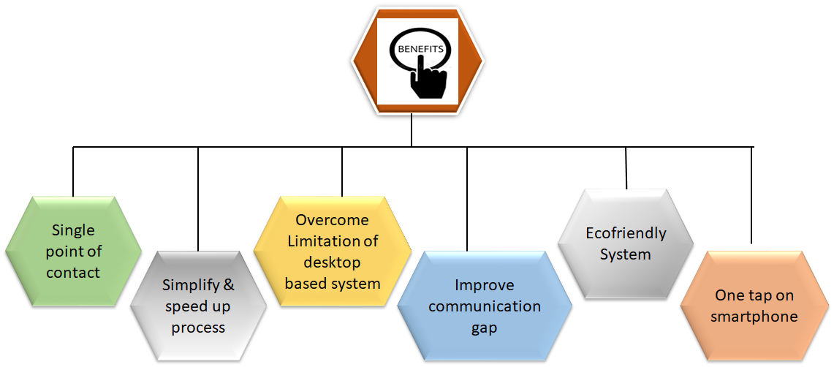

Slide 13
Conclusion
This system establish relationship between alumni and organization.
Graduated add their information.
Time Saving Reduce the paper work.

Slide 14
Thank You

